Slide 1
PREDICTING CUSTOMER BUYING BEHAVIOUR
Training a machine learning model

Slide 2
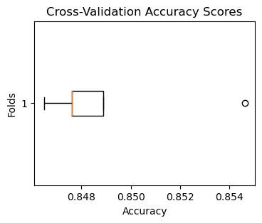
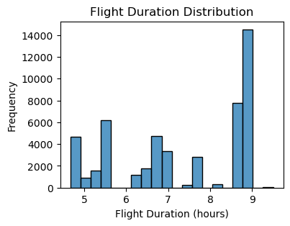
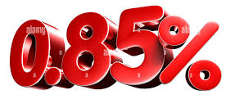
CUSTOMER BOOKING
ACCURACY
CROSS VALIDATION

